Slide 1
Chronic Kidney Disease Prediction Using XGBoost and LightGBM Gradient-Boosted Trees
Presented by:
2520030170-ABHIRAM
2520030299-SHAILA

Slide 2
2
Title Justification
  Chronic Kidney Disease Prediction → Predicting whether a patient has CKD or Not CKD.
  XGBoost and LightGBM → Two machine learning algorithms used for prediction.
  Gradient-Boosted Trees → Both XGBoost and LightGBM are based on gradient-boosted decision trees.
  Patient Clinical Data → Medical and laboratory parameters are used for prediction.

Slide 3
3
DOMAIN & OBJECTIVE SCOPE
Healthcare & Machine Learning
Domain:
  Healthcare / Medical Data Analytics
  Machine Learning Classification
Objective:
  Predict whether a patient is likely to have Chronic Kidney Disease (CKD) or Not CKD.
  Use patient clinical and laboratory information as input.
  Train and compare XGBoost and LightGBM models.

Slide 4
4
PROBLEM STATEMENT
Chronic Kidney Disease (CKD) requires timely identification and medical evaluation. However, analyzing multiple clinical and laboratory parameters such as age, blood pressure, blood glucose, serum creatinine, and hemoglobin to identify CKD patterns can be challenging. Therefore, this project aims to develop a machine learning-based system that predicts whether a patient is likely to have CKD or not using patient clinical data, while evaluating and comparing XGBoost and LightGBM models.

Slide 5
WHY XGBOOST & LIGHTGBM?
5
XGBoost
  Gradient-boosted decision-tree algorithm.
  Learns complex patterns from patient data.
  Uses regularization to help control overfitting.
  Suitable for structured/tabular datasets.
.
LightGBM
  Gradient-boosted tree algorithm.
  Designed for efficient and fast model training.
  Suitable for large-scale tabular data.
  Can efficiently handle complex feature relationships.
.

Slide 6
KEY MODEL ADVANTAGES
6
Non-Linear Modeling
  Can learn complex relationships between clinical parameters.
  No need to manually define rules for every parameter combination.
Feature Interaction
  Can capture interactions among different patient measurements.
Efficient Training
  LightGBM is designed for fast and efficient gradient boosting.
Regularization
  XGBoost provides regularization techniques that help reduce overfitting.

Slide 7
CHOOSING DATASET
7
Target Variable:
The target variable represents the CKD classification, with two possible outcomes: CKD and Not CKD.
Clinical & Laboratory Inputs:
The dataset contains patient information such as age, blood pressure, blood glucose, blood urea, serum creatinine, hemoglobin, albumin, and sugar.
Data Preparation:
The dataset will be prepared by handling missing values, converting categorical values into numerical form, and handling incorrect or inconsistent data.

Slide 8
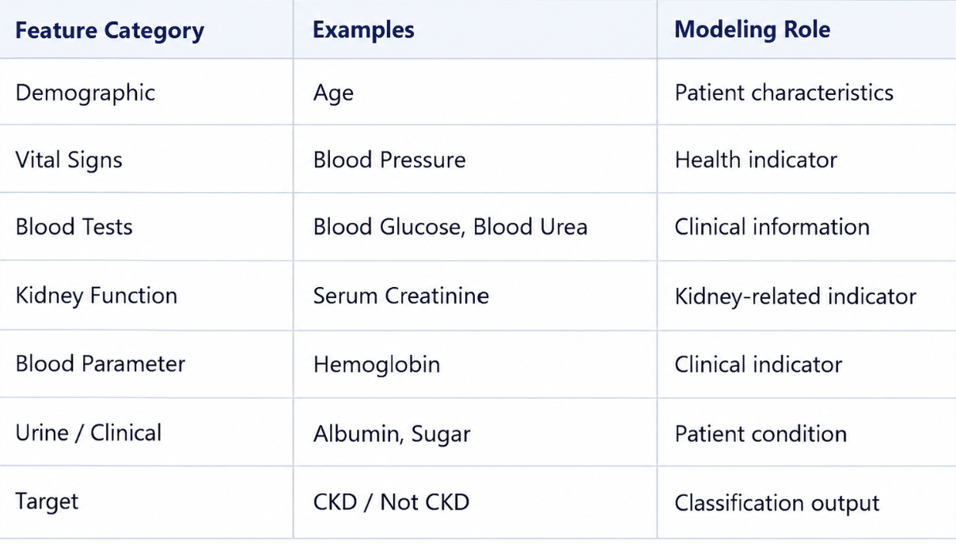
DATASET SCHEMA & FEATURE STRUCTURE
8

Slide 9
9
DATASET SCALE & VOLUME
  Dataset Type: Structured tabular medical dataset
  Task: Binary Classification
  Target: CKD / Not CKD
  Features: Clinical and laboratory patient parameters
  Rows: To be filled from selected dataset
  Columns: To be filled from selected dataset

Slide 10
10
EXPECTED OUTCOME
  Develop a machine-learning-based CKD classification system.
  Predict CKD / Not CKD using patient clinical data.
  Evaluate XGBoost and LightGBM using multiple metrics.
  Analyze the performance of both models.
  Compare the models based on the obtained evaluation results.

Slide 11
11
CONCLUSION
This project applies machine learning to Chronic Kidney Disease classification using patient clinical data. XGBoost and LightGBM are trained to classify patients as CKD or Not CKD. Their performance is evaluated using accuracy, precision, recall, F1-score, specificity, ROC-AUC and confusion matrix, providing a systematic comparison of the two gradient-boosted tree models.

Slide 12
12
THANK YOU

